Slide 1

Analysis of AMEO Dataset (2015)

Slide 2
About me :
Myself Lekhan, working as an Assistant Engineer in TCS
Completed my graduation as a Mechanical Engineer in 2021 from National Institute of technology, Warangal
Data Science was my field of interest from the beginning, working on this since 2 years.
The way Data science uses the combination of Machine Learning with Statistics and Calculus is fascinating
The advancement in the field Machine Learning like GPT’s and LLM’s caught my interest.
I want to build my career in this field and contribute to the fullest

Slide 3
Index :
Objective
Summary of Data
Data Pre-processing
Feature Engineering
Exploratory Data Analysis
Research Questions
Conclusion

Slide 4
1. Objective
To perform Exploratory Data Analysis on AMEO Dataset.
To get better understanding each feature by interpreting in different forms using statistical tools.
To understand the relationship of each feature with ‘Salary’ and observe different trends, patterns.
2. Summary of Data
The dataset was released by Aspiring Minds from the Aspiring Mind Employment Outcome 2015 (AMEO). The study is primarily limited only to students with engineering disciplines. The dataset contains the employment outcomes of engineering graduates as dependent variables (Salary, Job Titles, and Job Locations) along with the standardized scores from three different areas – cognitive skills, technical skills and personality skills. The dataset also contains demographic features.

Slide 5
The dataset contains around 40 independent variables and 4000 data points. The independent variables are both continuous and categorical in nature. The dataset contains a unique identifier for each candidate.
3. Data Pre-processing
The Pre-processing starts with loading the data, size of dataset and number of features.
Typecasted the data into the right data type.
Date features were converted into pandas date time format.
The DOL for the employees who are working in the company is considered as present date since the report was published on 2015.
Numerical continuous features the outliers are removed using Fencing for better data analysis.
Categorical features with high cardinality were removed.

Slide 6
Outliers for categorical features were added to a new feature ‘others’.
Null values of features were dropped due to less frequency.
Spelling correction done for ’10thboard’ using fuzzywuzzy for better data understanding.
Before proceeding the next step features ‘ID’,’CollegeCityID’, 'Designation', 'JobCity', '10board', '12board’, 'Specialization’ are removed as discussed or not needed.
Feature ‘Domain’ was removed since unable to interpret the data into right format.
Data pre-processing done for all features along with feature engineered columns.
4. Feature Engineering
Age :
The columns ‘DOB’ is converted to age for better Data Analysis.

Slide 7
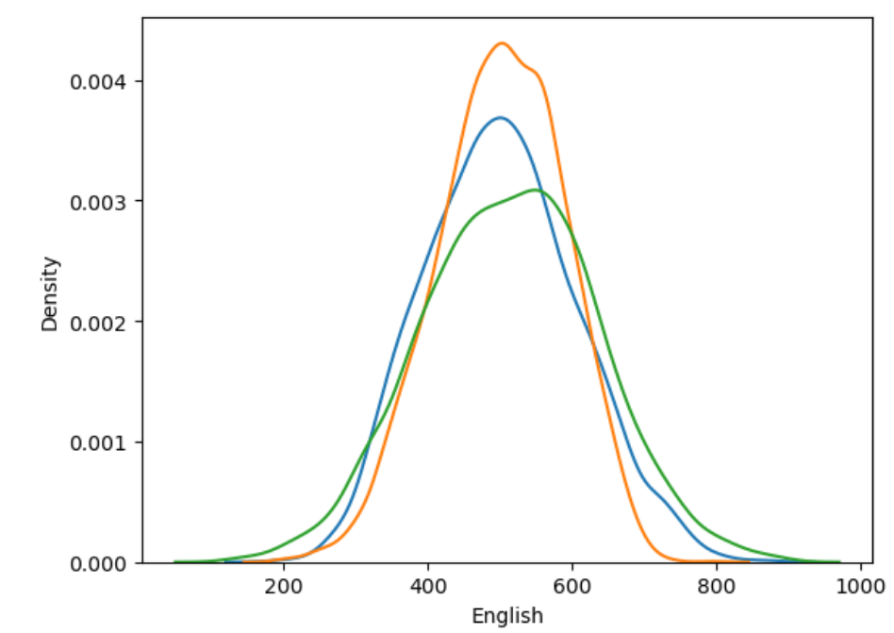
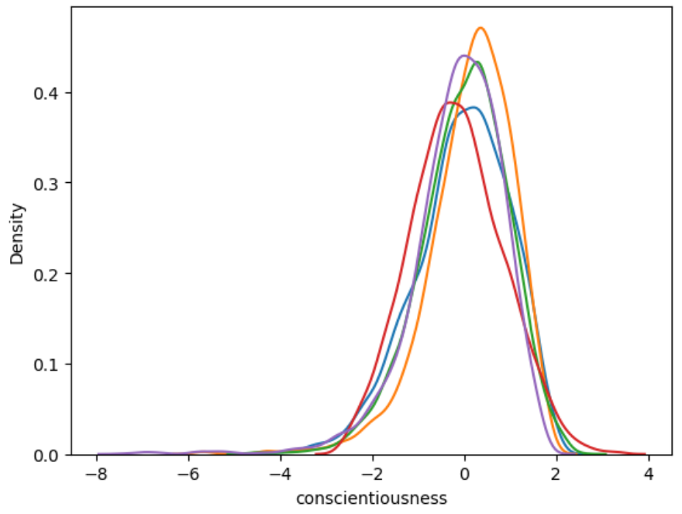
Cognitive :
The columns ‘English’, ‘Logical’, ‘Quant’ are taken average to create a new ‘Cognitive’ since these features represent cognitive skills and have similar distributions.
Personality :
The columns ‘conscientiousness’, ‘agreeableness’, ‘extraversion’ , ‘nueroticism’ and ‘openess_to_experience’ are taken average to create a new ‘Personality’ since these features represent Personality skills and have similar distributions.

Slide 8
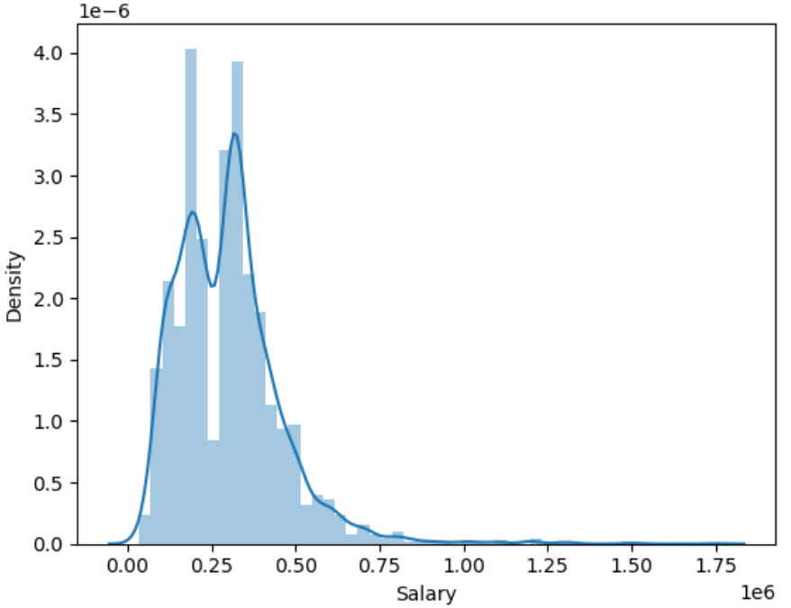
Service :
Service indicates the time period an employee spent in the company. Service is calculated by DOL – DOJ.
5. Exploratory Data Analysis
Salary :
The distribution of salary shows indicates positive skewness and moderately high Kurtosis.
The median salary of an employee is 3,00,000 INR and the lowest wage is 35000 INR.

Slide 9
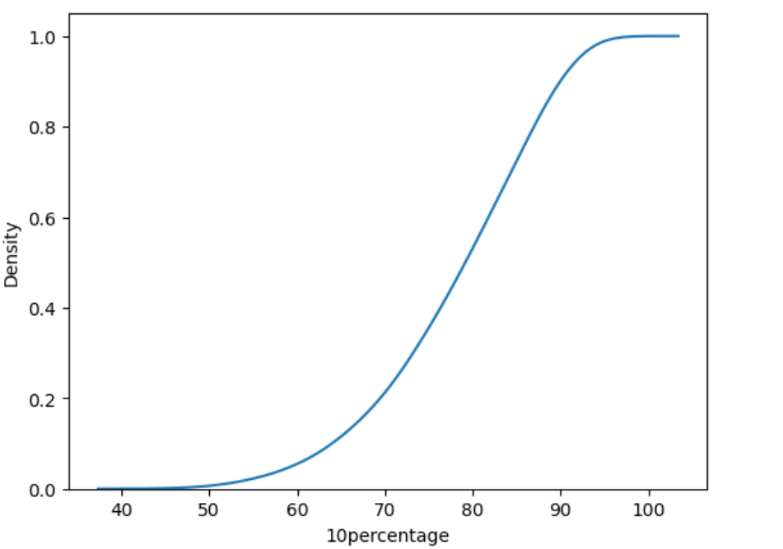
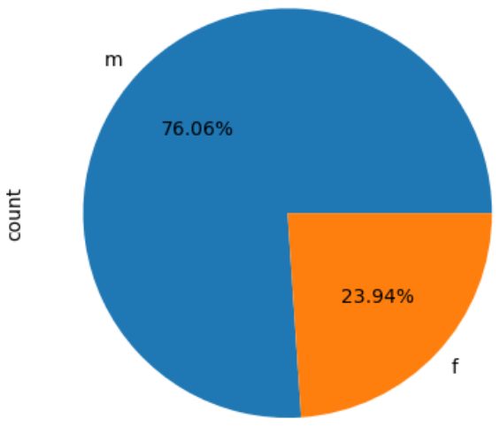
10th ,12th Percentage and collegeGPA:
All the three features follow similar distributions.
More than half of the students got at least 70% and above.
The distribution represents a normal distribution.
Gender:
The pie chart shows the percentage of Male and Female who are working .
We can observe that the Gender data is completely biased towards Male employees and similar trends can be observed while performing Bi-Variate analysis with other data points.

Slide 10
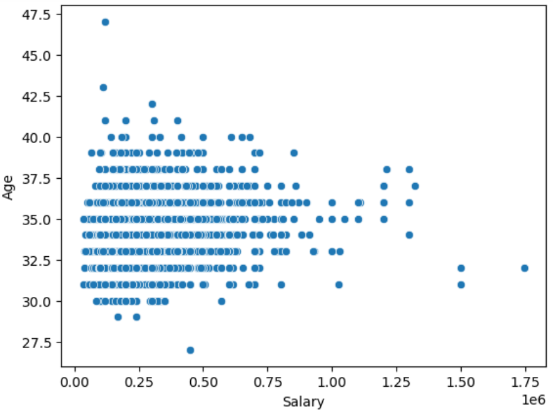
Bi-Variate Analysis
Salary VS Age:
The scatter plot show how the salary changes with the employees at each age group.
Initially the employee salary is on the lower side assuming the person starts as a Fresher.
As the person age increases we can clearly observe the increase in salary showing relationship with age.
Decrease in median salary was observed after the age of 36.
The correlation between Age and Salary 0.17.

Slide 11
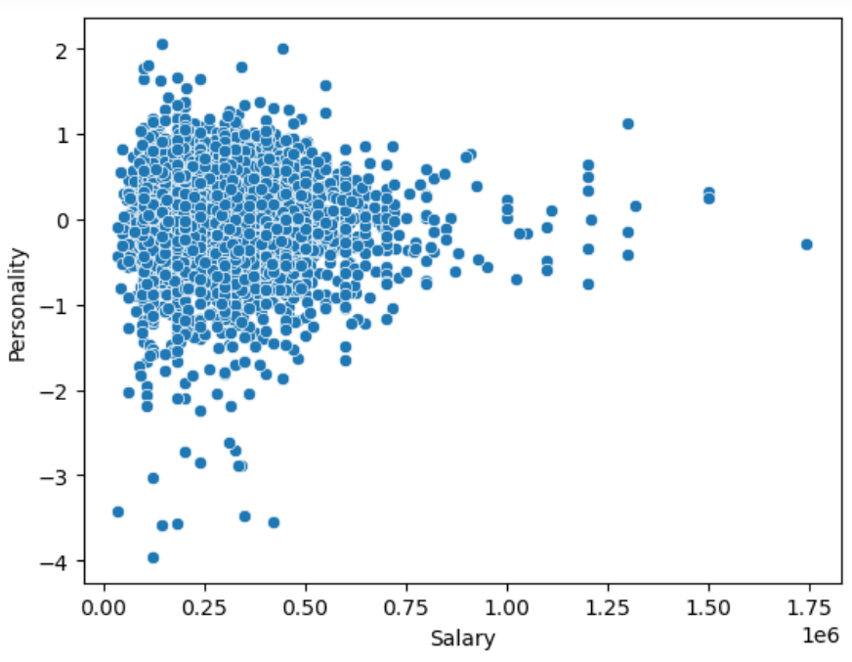
Salary VS Personality:
Personality is a new Feature, Feature Engineered from 'conscientiousness’, 'agreeableness’ ,'extraversion’, 'nueroticism’ and 'openess_to_experience’.
‘Personality’ represents the over all personality skill an employee.
The Scatter plot shows the Salary of an
employee at each personality score and
we can infer that the employees whose
personality score less than -1 are
unable to grab higher salaries
compared to other employees with
scores.
The correlation factor for Salary and
personality is -0.03

Slide 12
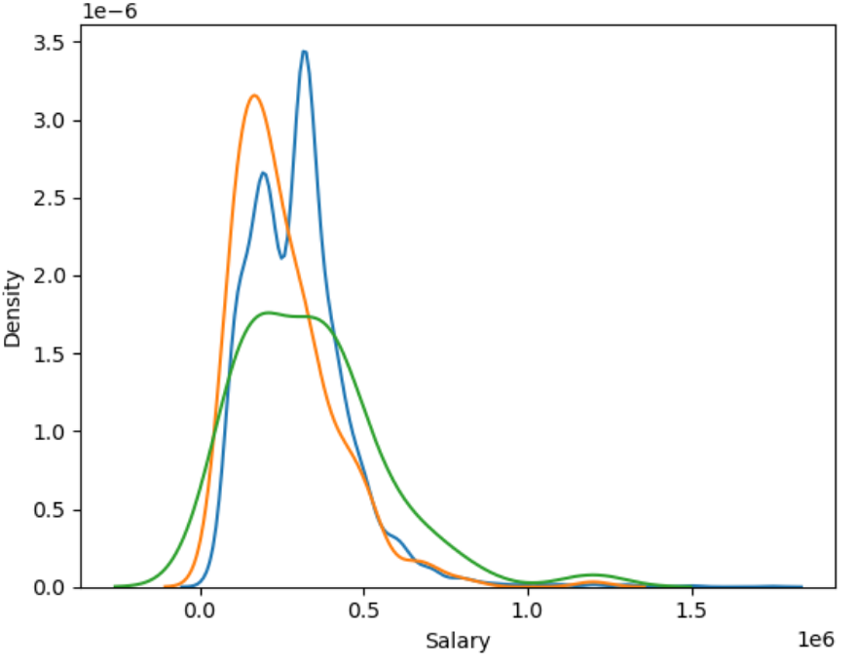
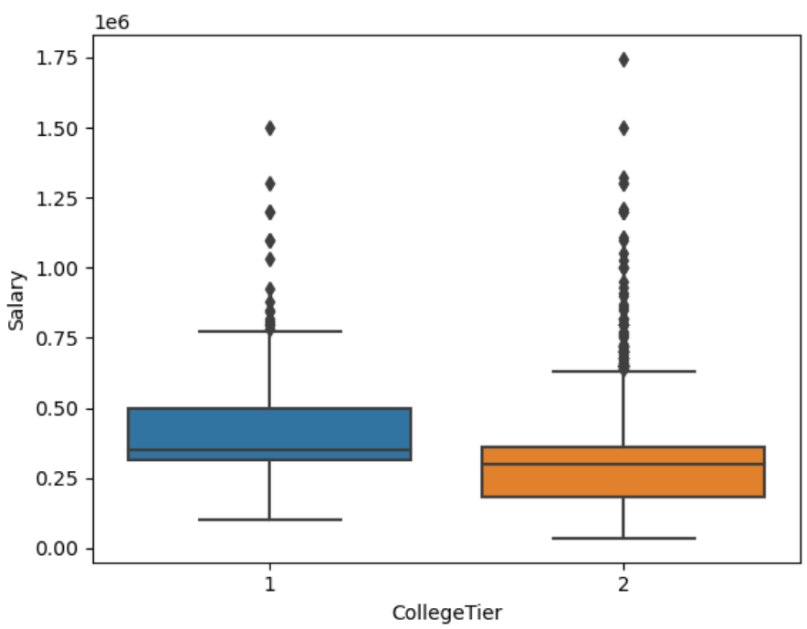
Salary VS Degree:
Salary VS CollegeTier:
The KDE plot shows the relationship between Salary and various Degree fields.
From the graph we can infer that the
people who pursued m.tech./m.e. has
lower median salary compared to
b.tech/b.e. and mca.
The Box plot shows the relationship between Salary and CollegeTier
We can observe that the Salaries given in Tier-1 cities have higher Median salary and higher inter quantile range compared to Tier-2.

Slide 13
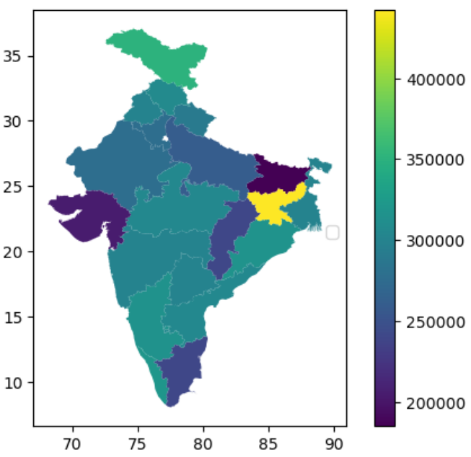
Salary VS CollegeState:
The Geo plot shown beside represents the median salary of an employee in each State.
The lowest median salaries are observed in the states of Gujarat and Bihar.
Jharkand has the highest Median salary.
From this data of salaries we can also infer that by join colleges in few states we can expect to get good salary packages in the future.

Slide 14
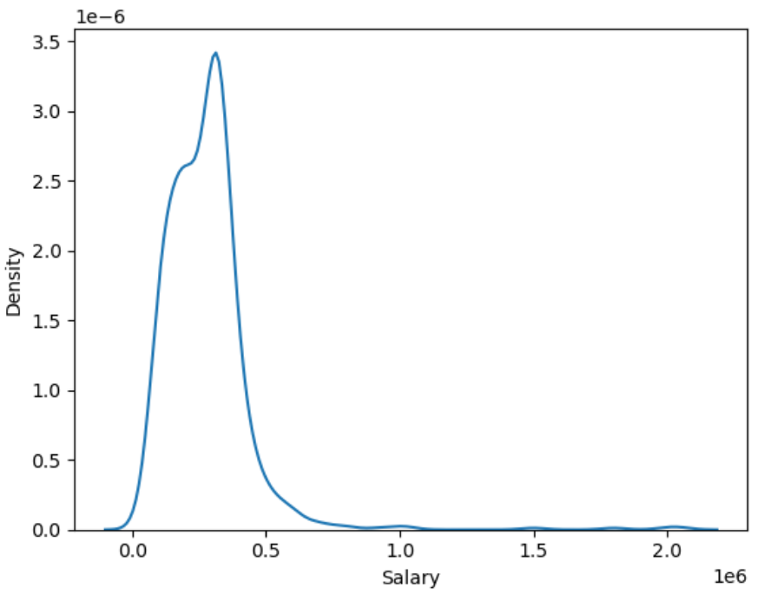
6. Research Questions
Times of India article dated Jan 18, 2019 states that “After doing your Computer Science Engineering if you take up jobs as a Programming Analyst, Software Engineer, Hardware Engineer and Associate Engineer you can earn up to 2.5-3 lakhs as a fresh graduate.” Test this claim with the data given to you.
Solution :
The Data has been filtered with Specialization as computer science & engineering
and Designation as Programming Analyst, Software Engineer, Hardware Engineer
and Associate Engineer. The resulting KDE plot is shown above.

Slide 15
Hypothesis testing was conducted and after checking distributions of different Job profiles with the given salary range.
We have sufficient evidence to reject the Null Hypothesis for Programming Analyst and Software Engineer.
Failed to reject the Null Hypothesis for Hardware Engineer and Associate Engineer due to insufficient evidence.
2. Is there a relationship between gender and specialization?
Solution :
The Gender feature contains 3040 Male datapoints and 957 datapoints for fair analysis lets take 500 random samples from each category.
The Stacked bar plot resulting is shown below with top 16 specializations for each category.

Slide 16
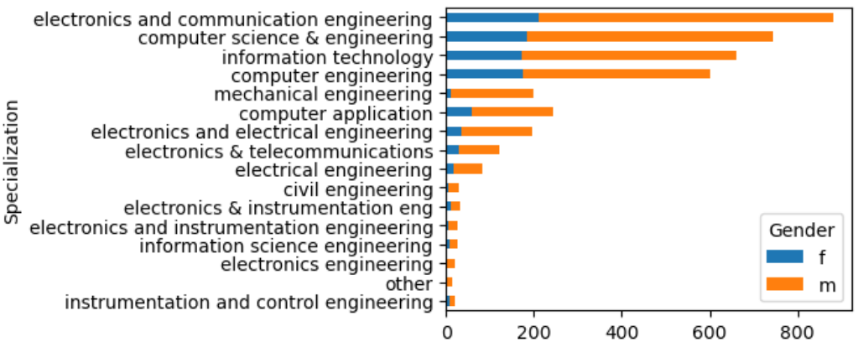
From the visual plot and Hypothesis testing we have enough evidence to
accept the Null Hypothesis.
The Specialization ‘Mechanical Engineering’ is observed to have highest
Gender bias.

Slide 17
7. Conclusion
After completing a thorough analysis on the AMEO dataset we have uncovered valuable insights, trends, patterns and areas of interest that are influencing ‘Salary’ such as ‘Age’, ‘Personality’, ‘CollegeTier’ etc.
These insights help the companies to take right decisions with respect to employee recruitment, employee maintenance and also students to choose right Specialization and Designation in the future.

Slide 18

THANK YOU

